Slide 1


Instructor Resources
Chapter 5 Figures
Cover photo: BeautyStock – stock.adobe.com.

Slide 2
Chapter 5
Major Aircraft Systems

Slide 3
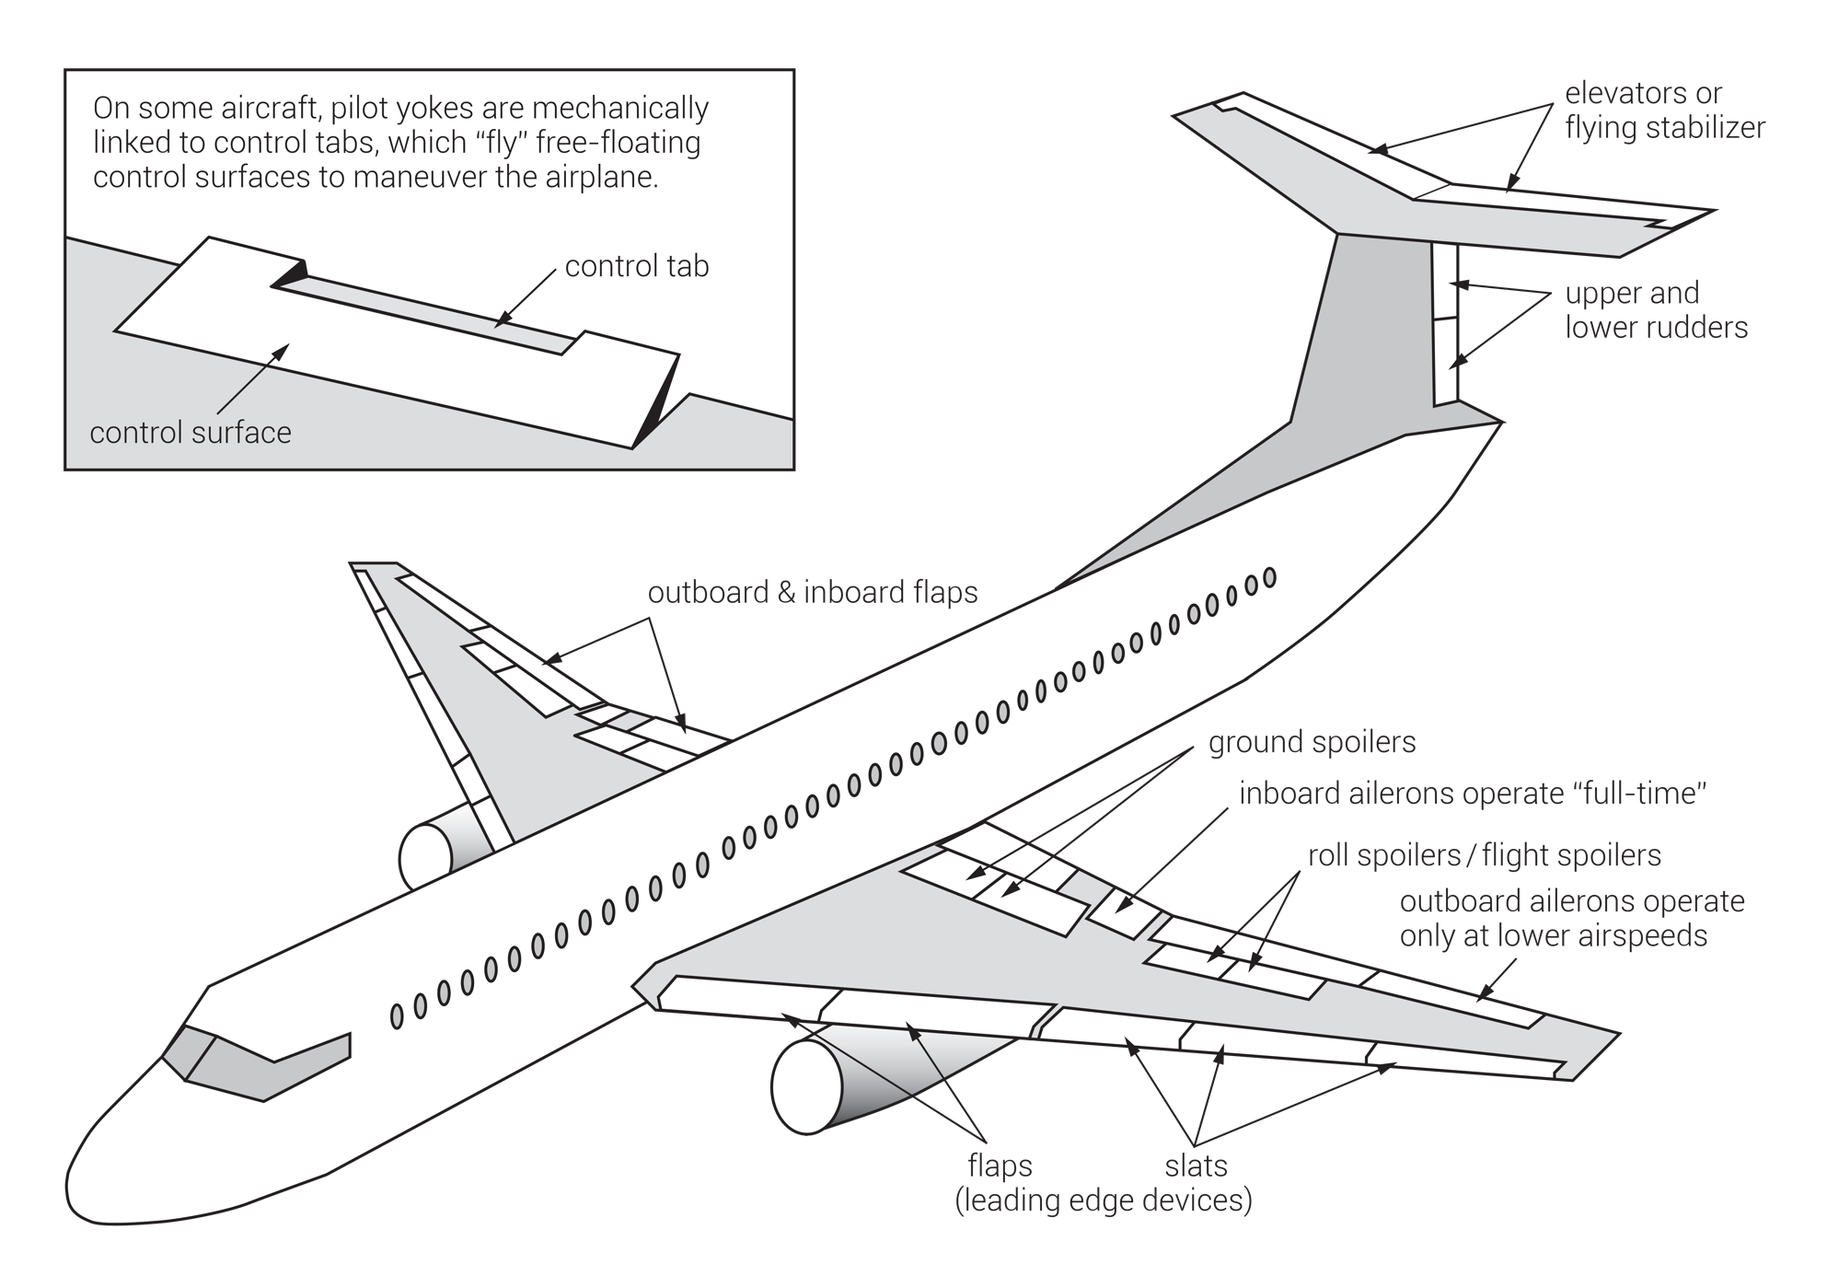
FIGURE 5.1
Flight control surfaces.

Slide 4
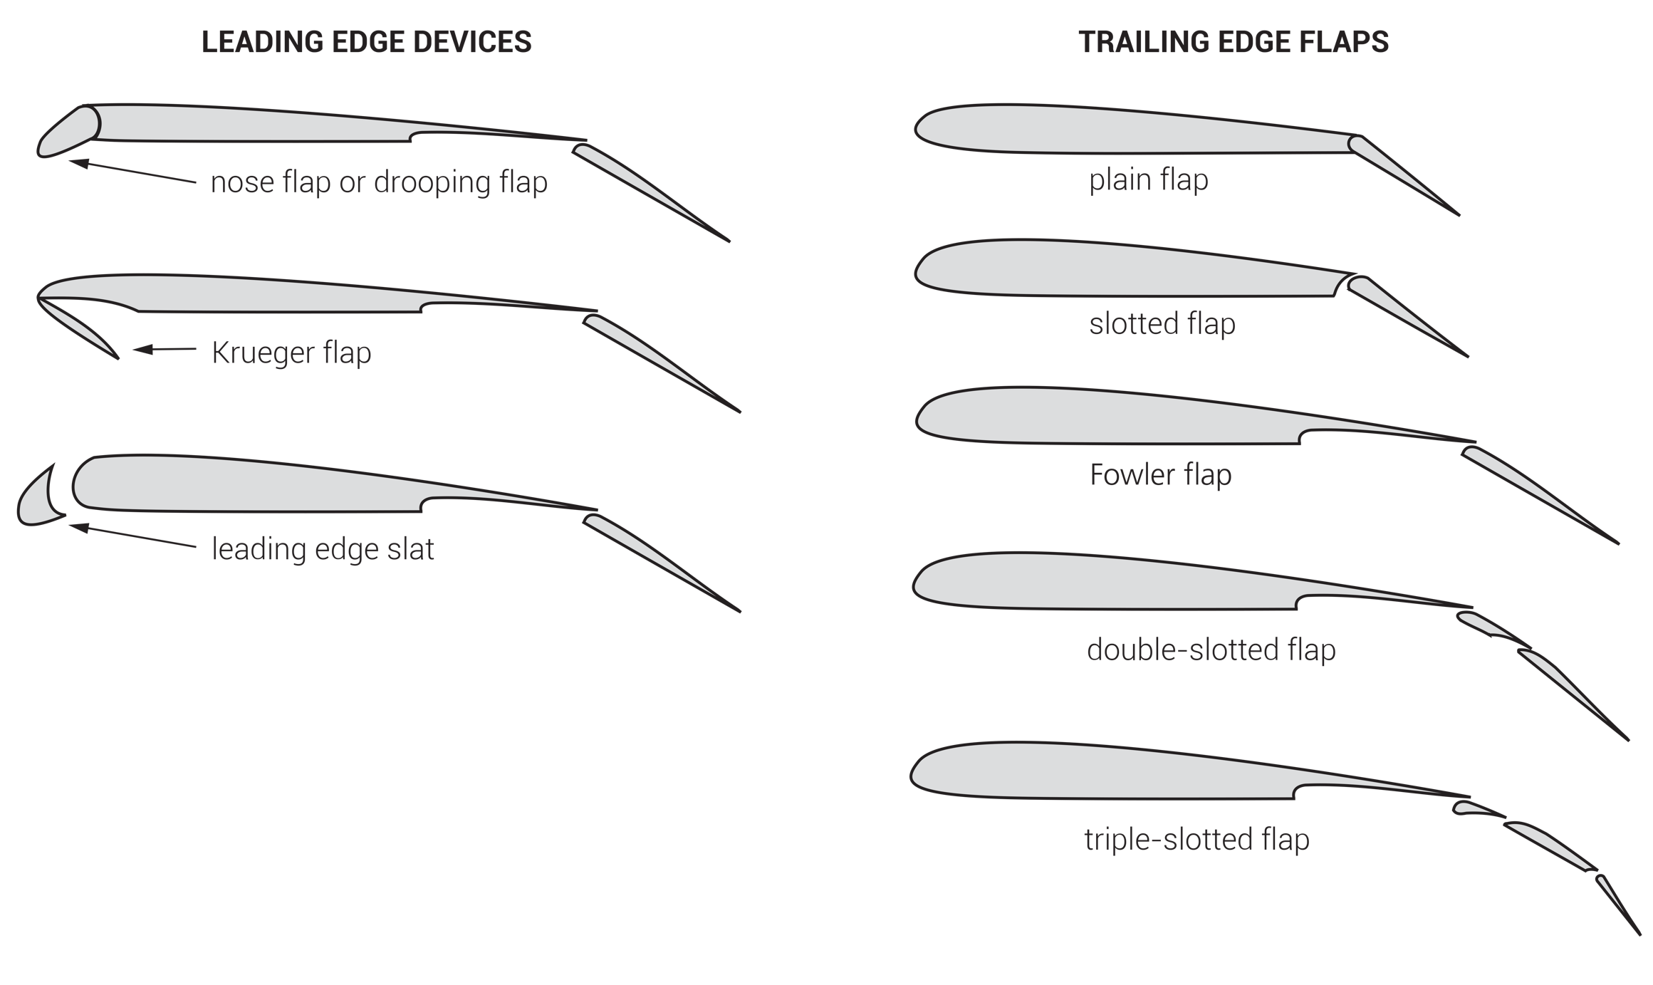
FIGURE 5.2
Trailing edge flaps and leading edge devices (LEDs).

Slide 5
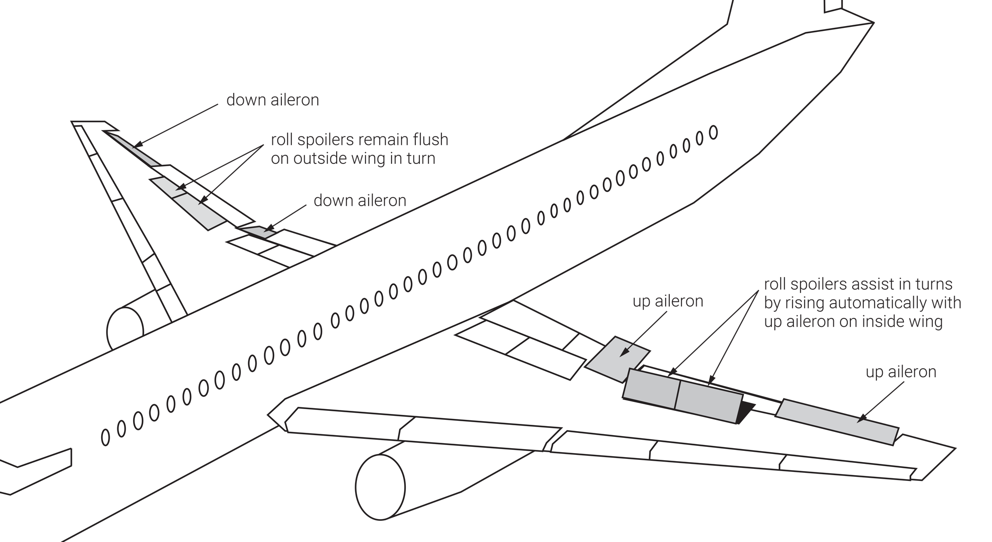
FIGURE 5.3
Roll spoilers.

Slide 6
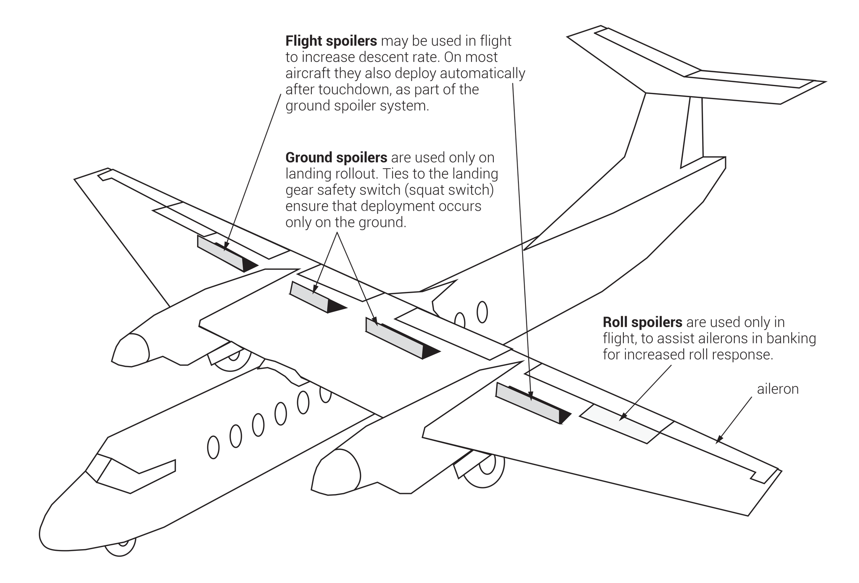
FIGURE 5.4
Ground and flight spoilers.

Slide 7
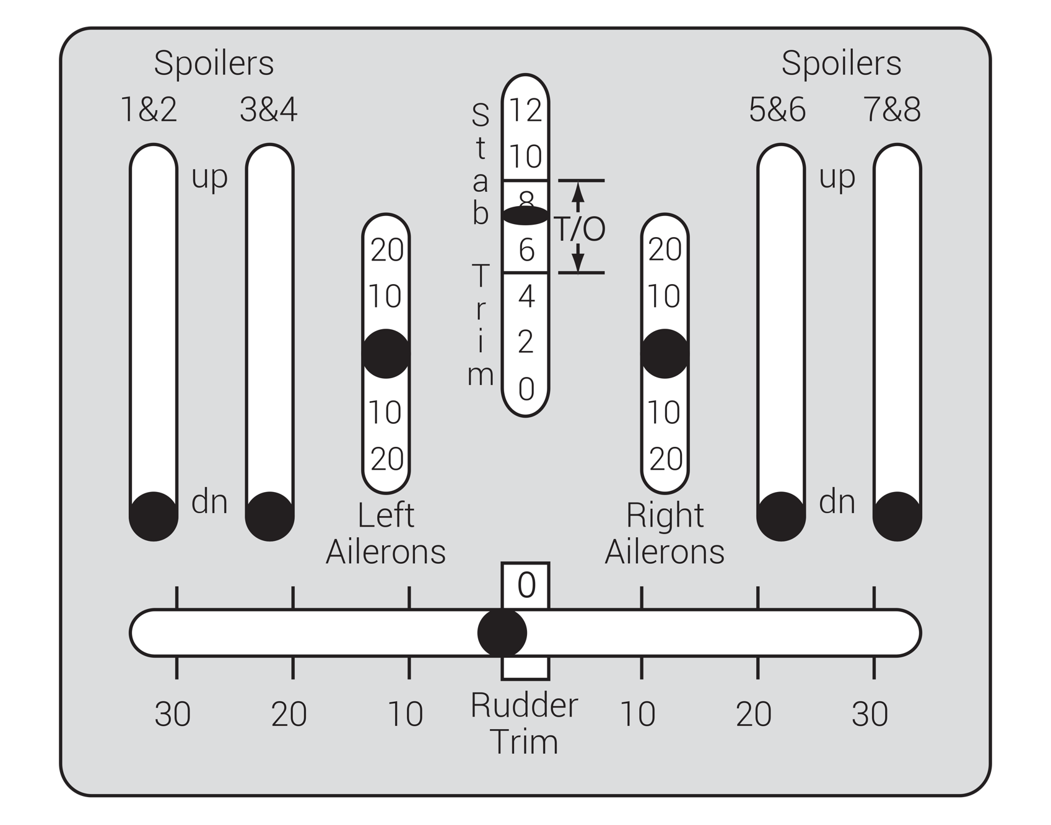
FIGURE 5.5
Flight control surface position indicator.

Slide 8
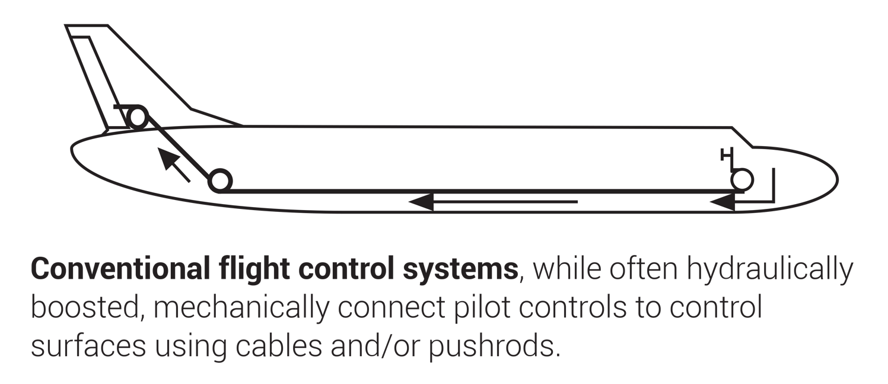
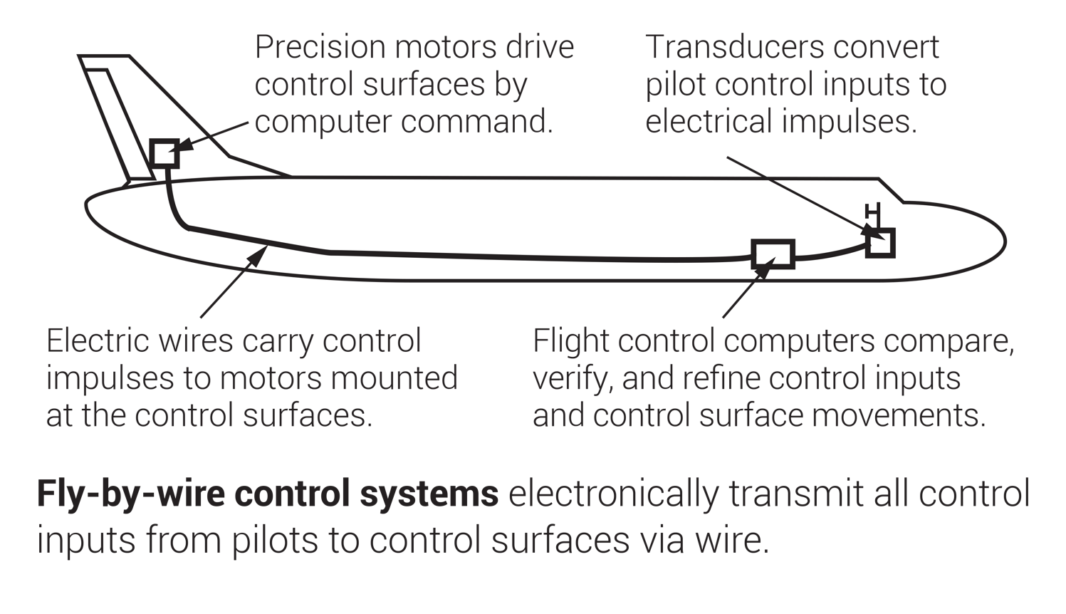
FIGURE 5.6
Fly-by-wire controls versus mechanical flight controls.

Slide 9
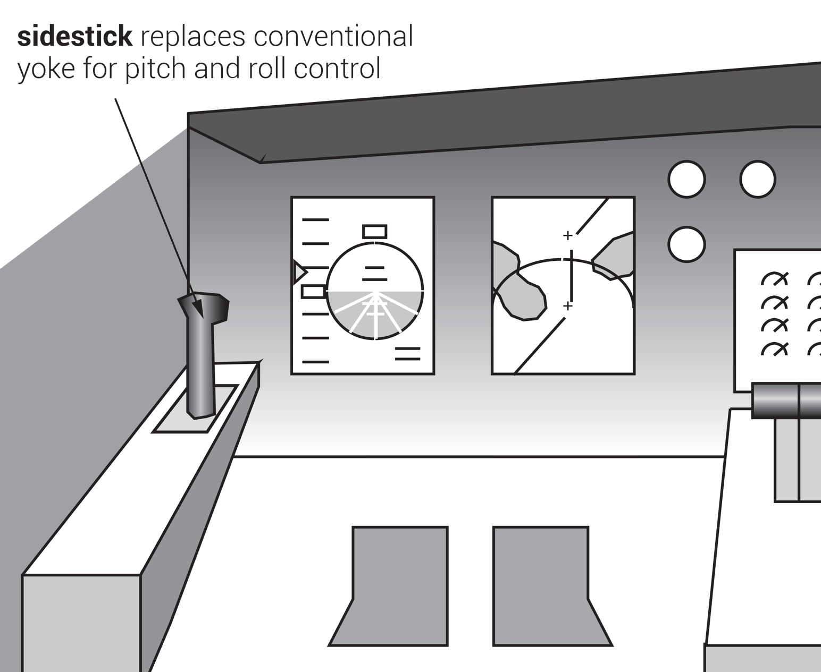
FIGURE 5.7
Sidestick controller used in some fly-by-wire aircraft.

Slide 10
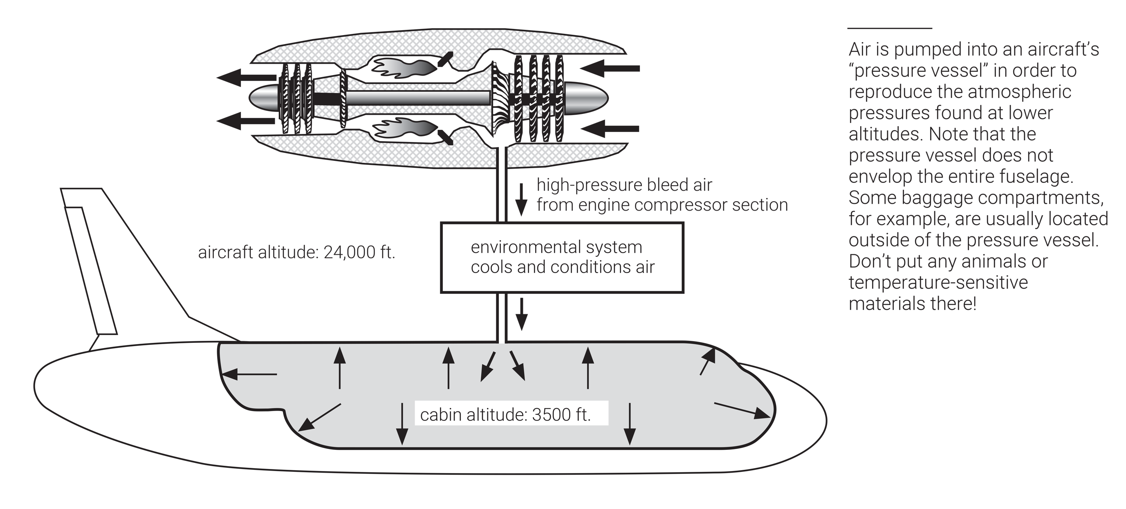
FIGURE 5.8
Cabin pressurization.

Slide 11
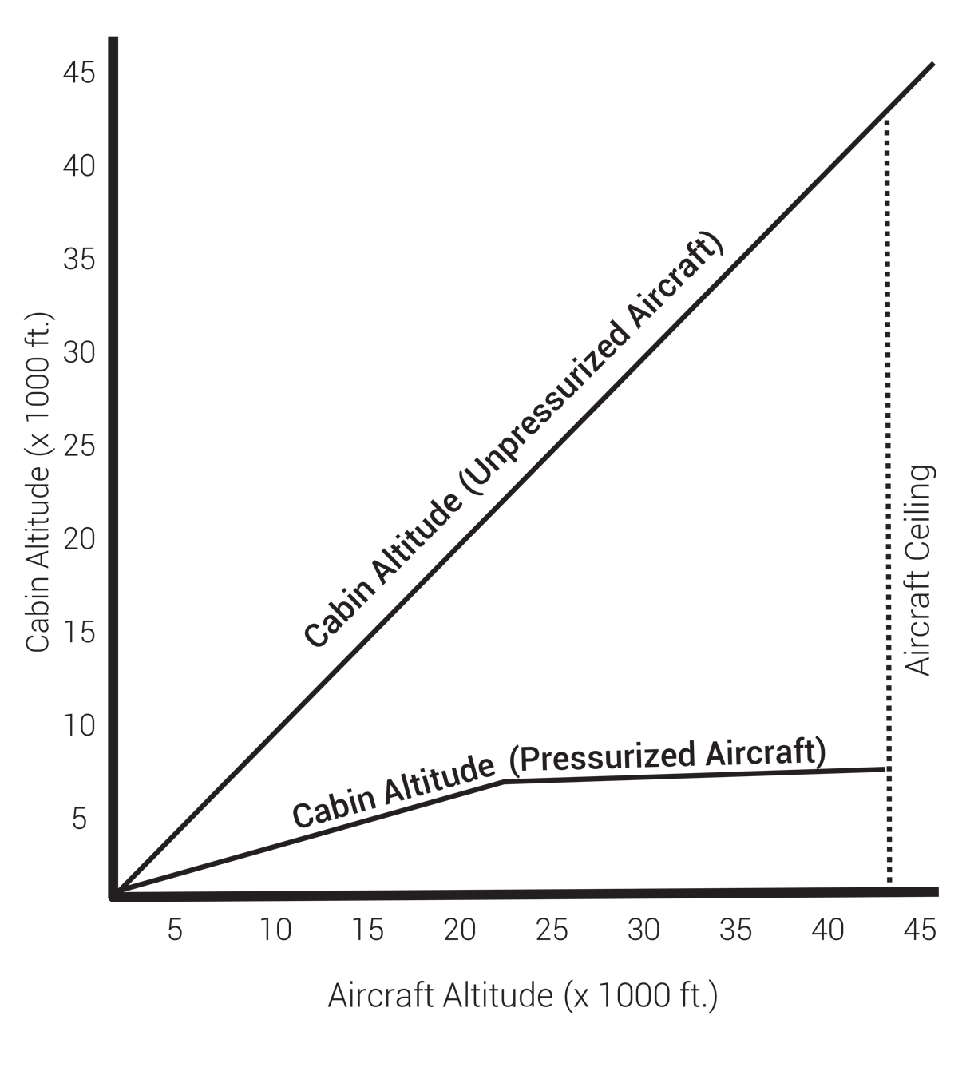
FIGURE 5.9
Cabin altitude versus aircraft altitude.

Slide 12
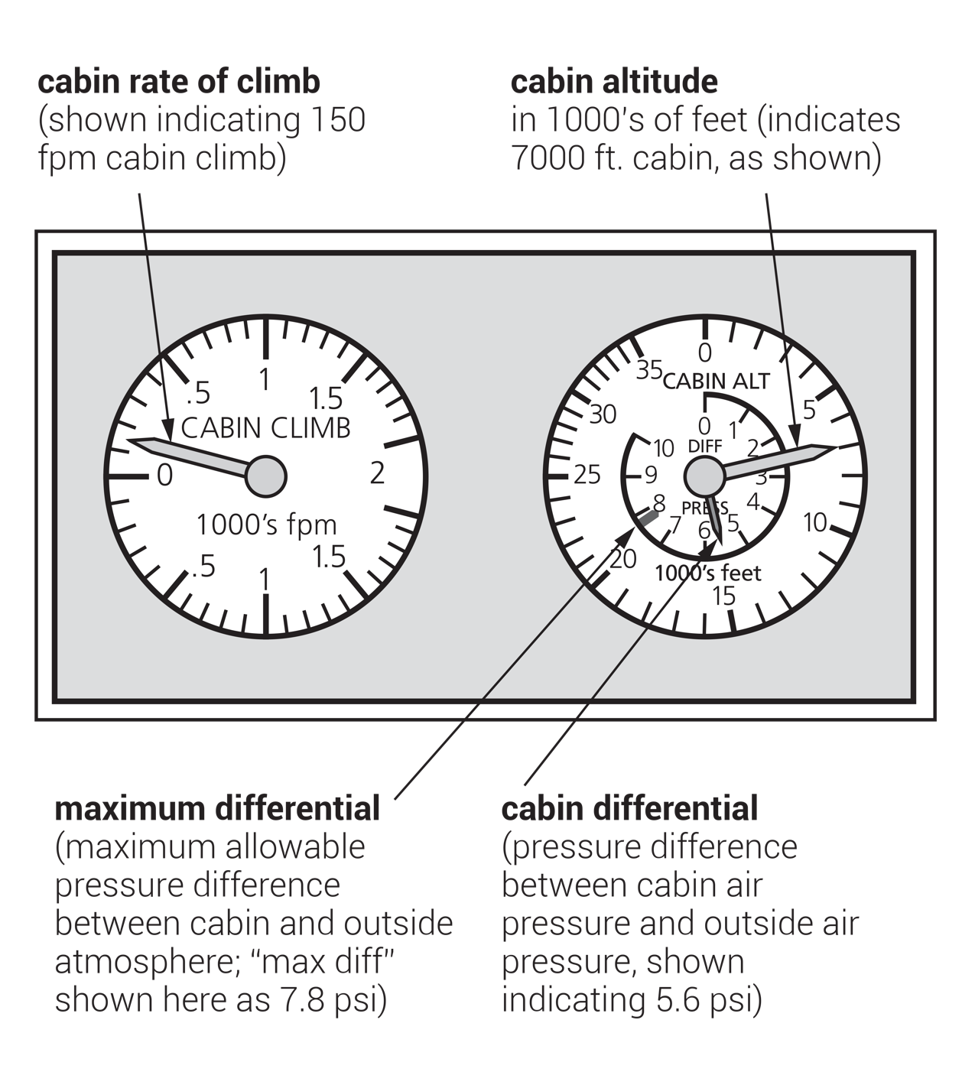
FIGURE 5.10
Cabin pressurization indicators.

Slide 13
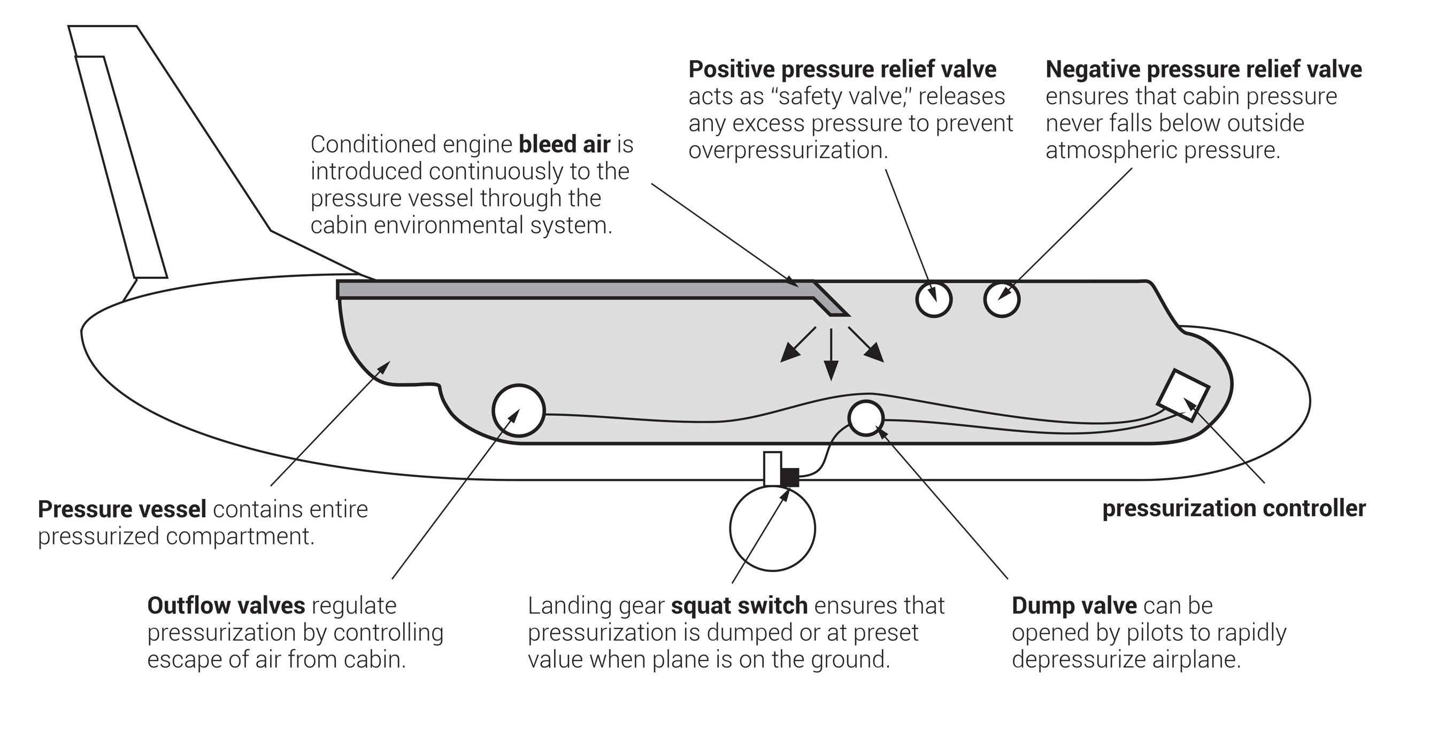
FIGURE 5.11
Pressurization system components.

Slide 14
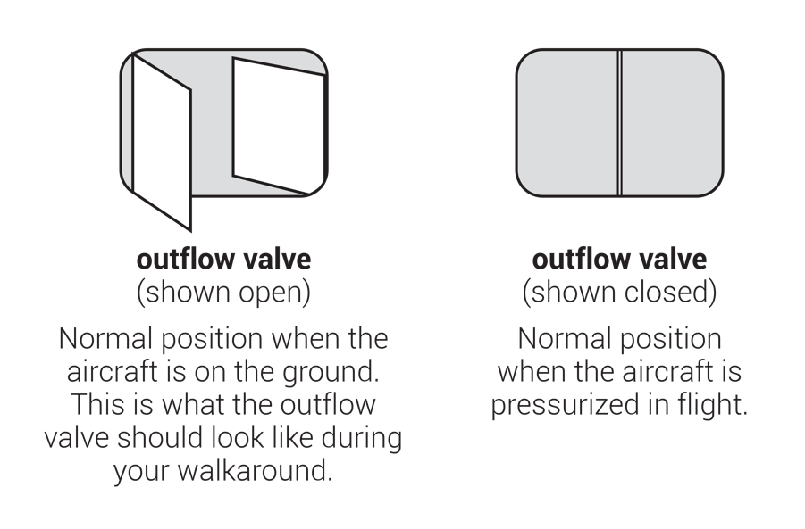
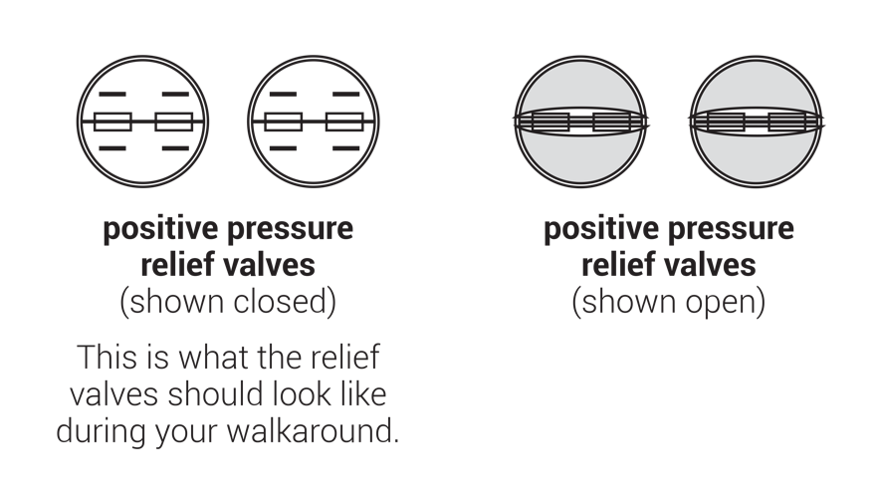
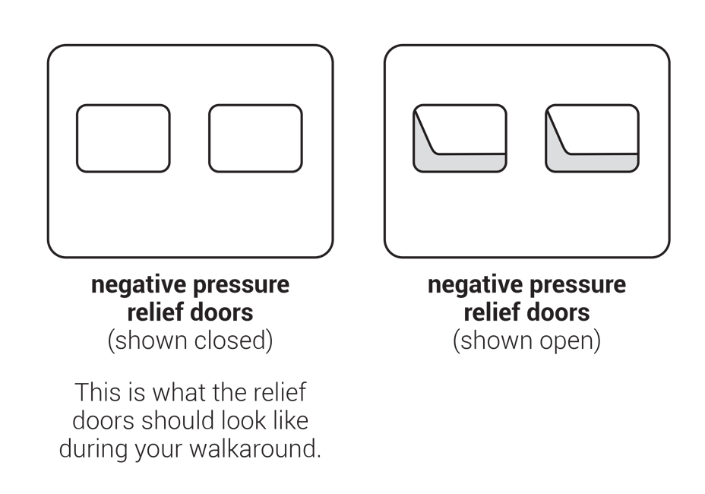
FIGURE 5.12
Pressurization valves as they appear on the exterior of the aircraft.

Slide 15
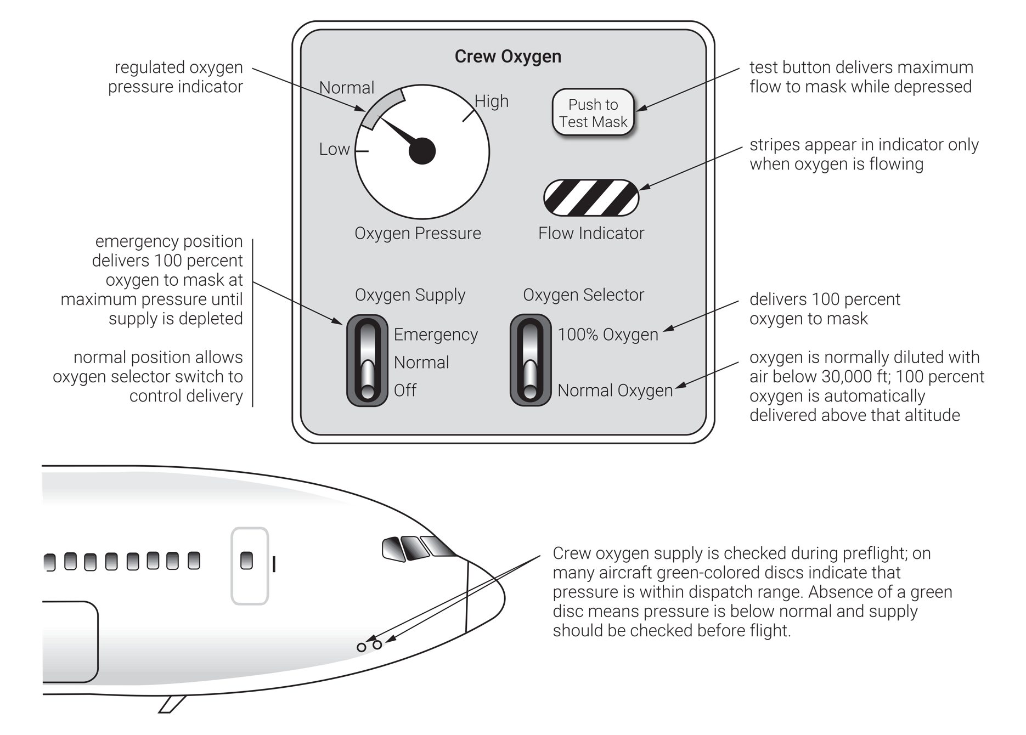
FIGURE 5.13
Crew oxygen regulator and overboard oxygen discharge indicators.

Slide 16
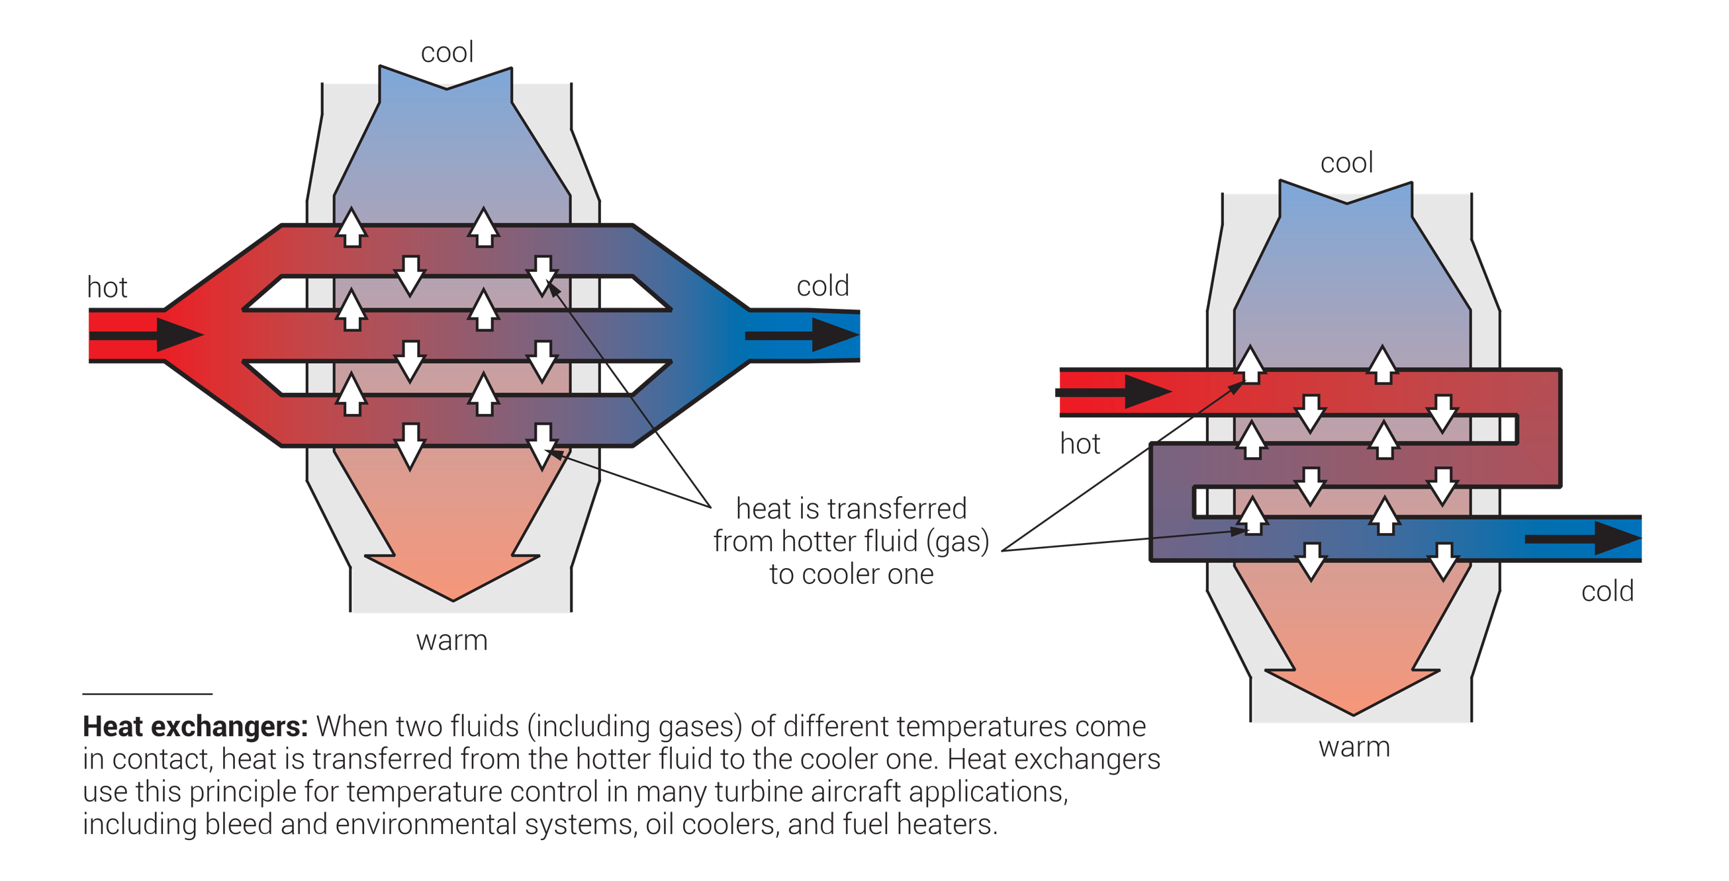
FIGURE 5.14
Heat exchangers.

Slide 17
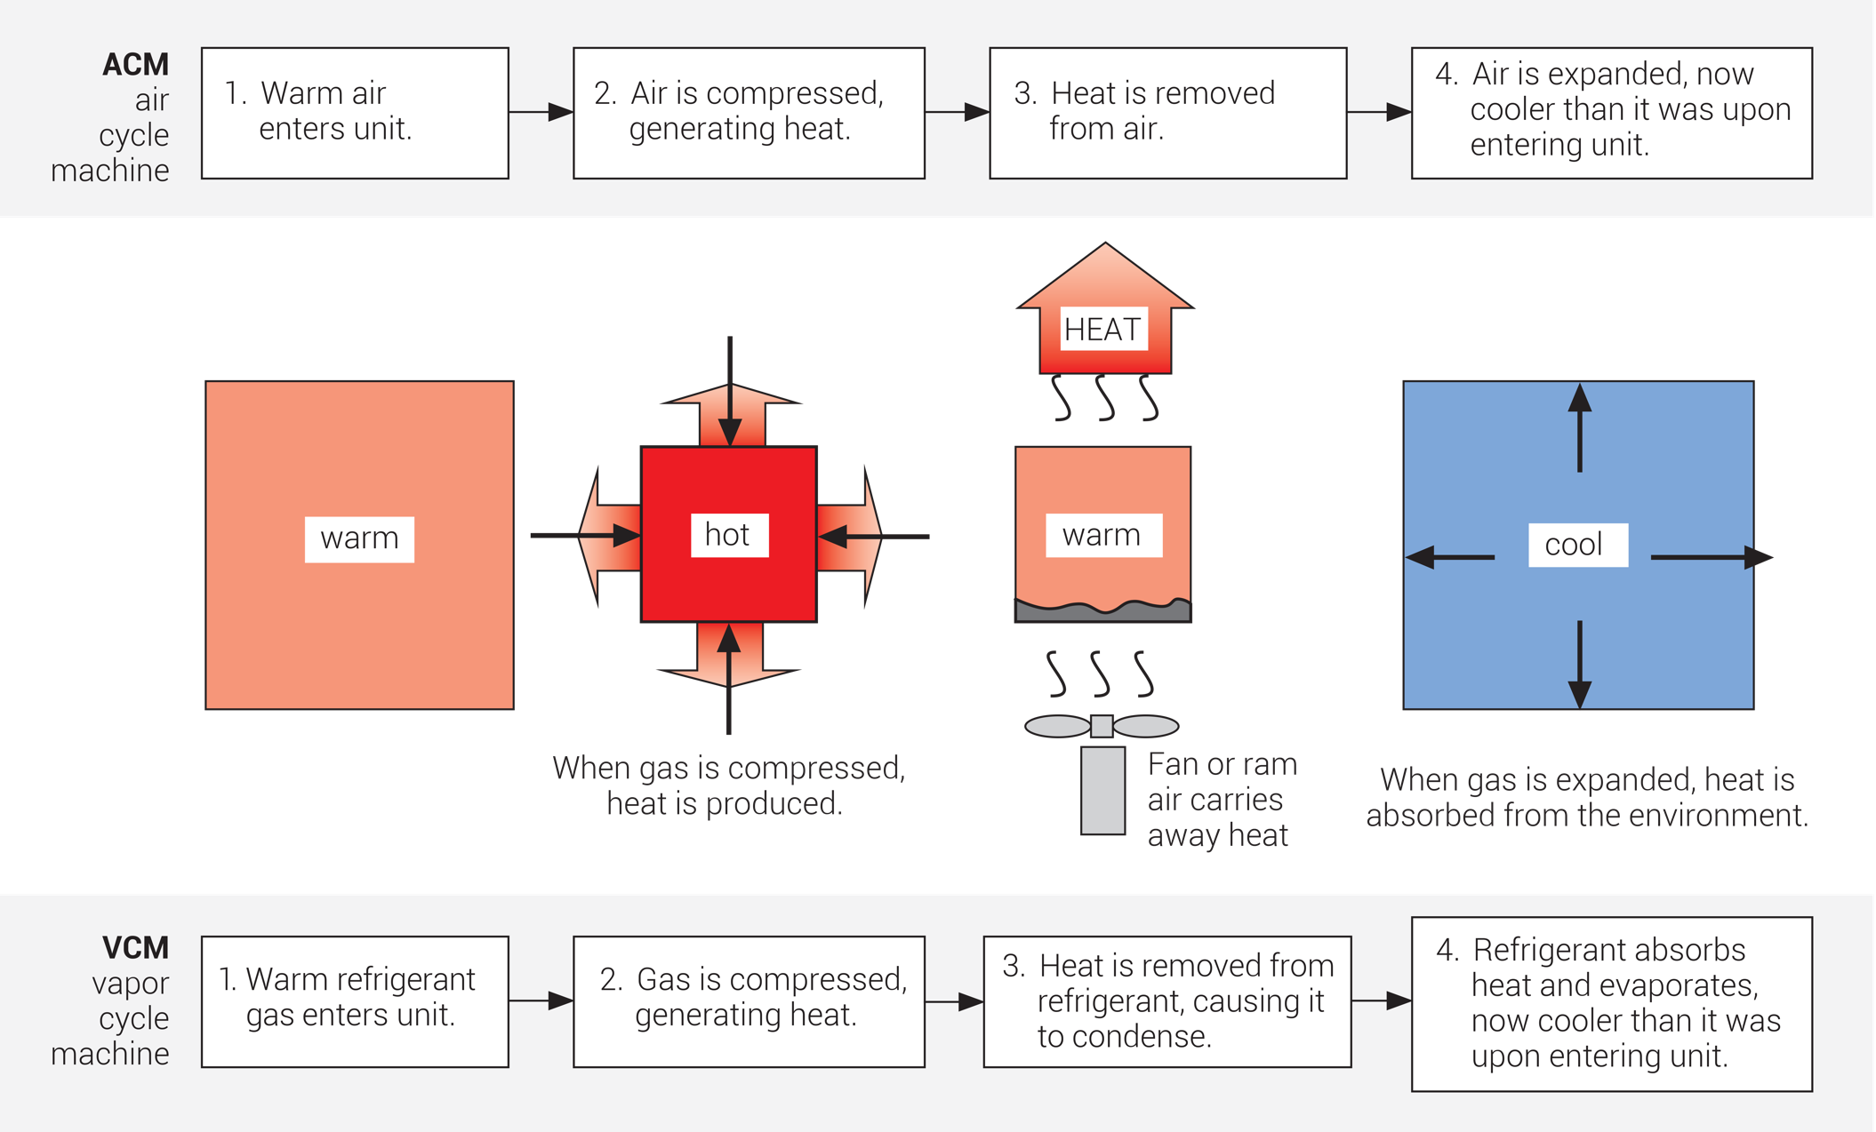
FIGURE 5.15
Operating principles of air cycle and vapor cycle machines.

Slide 18
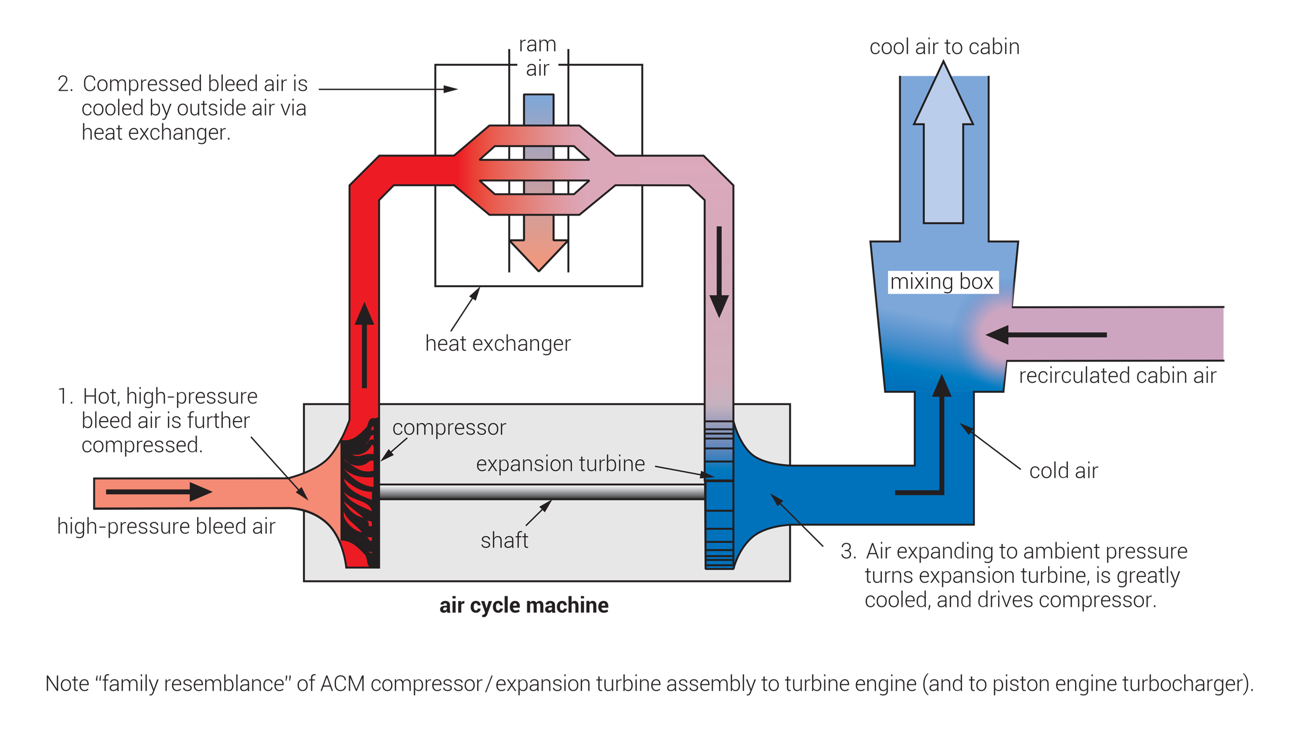
FIGURE 5.16
Air cycle machine (ACM).

Slide 19
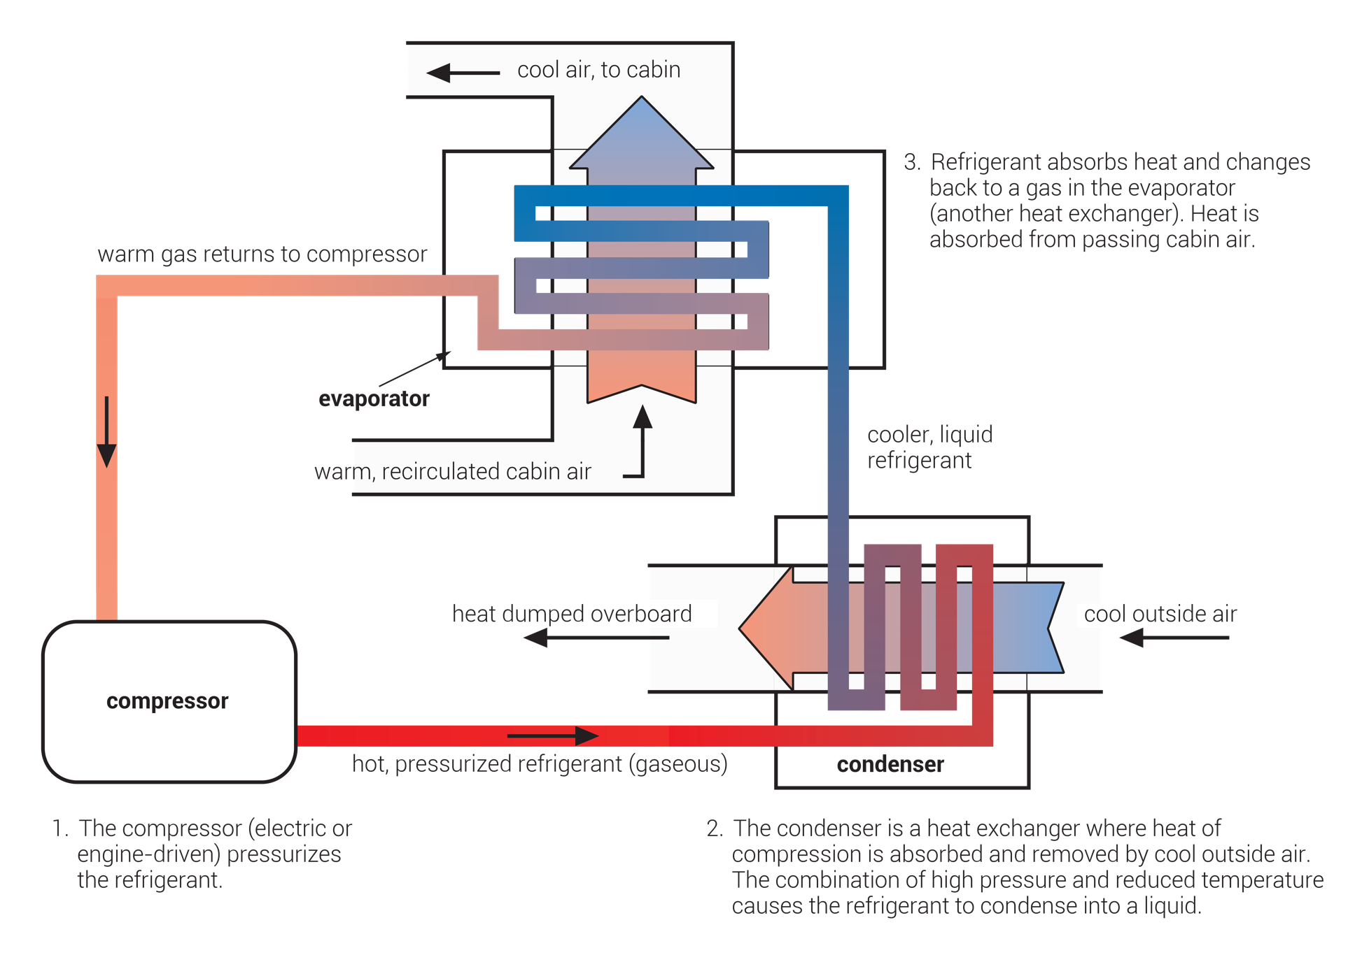
FIGURE 5.17
Vapor cycle machine (VCM, or “Freon unit”).

Slide 20
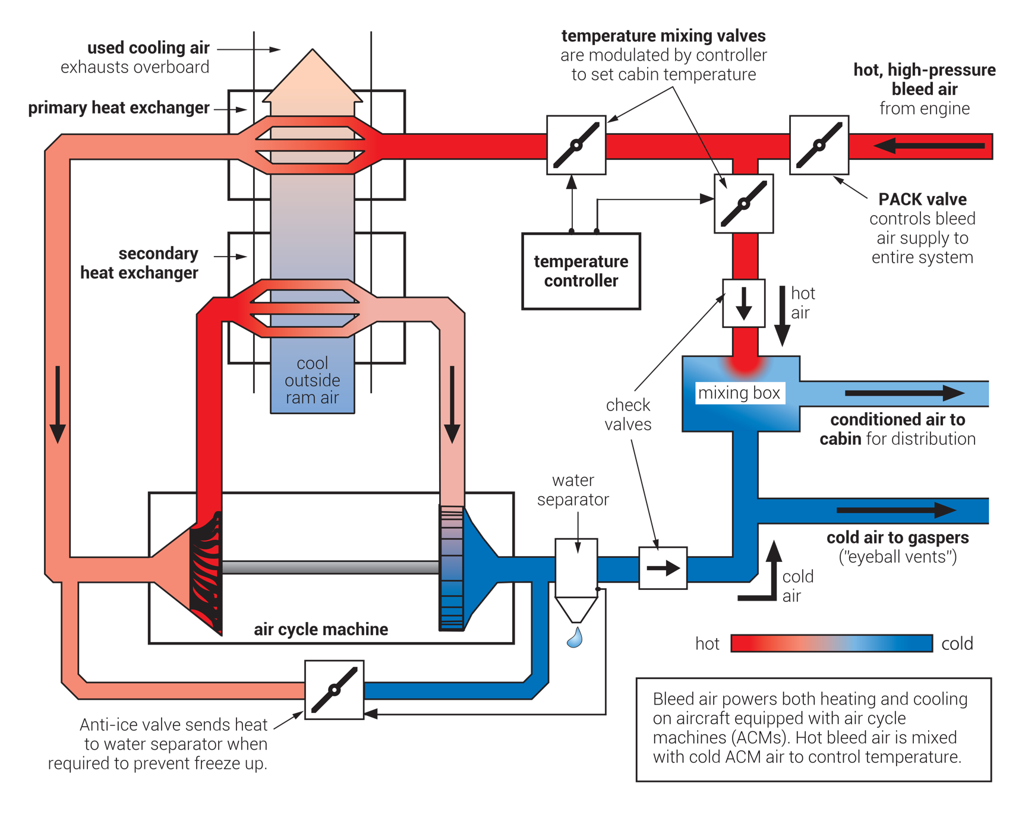
FIGURE 5.18
Aircraft environmental system (PACK).

Slide 21
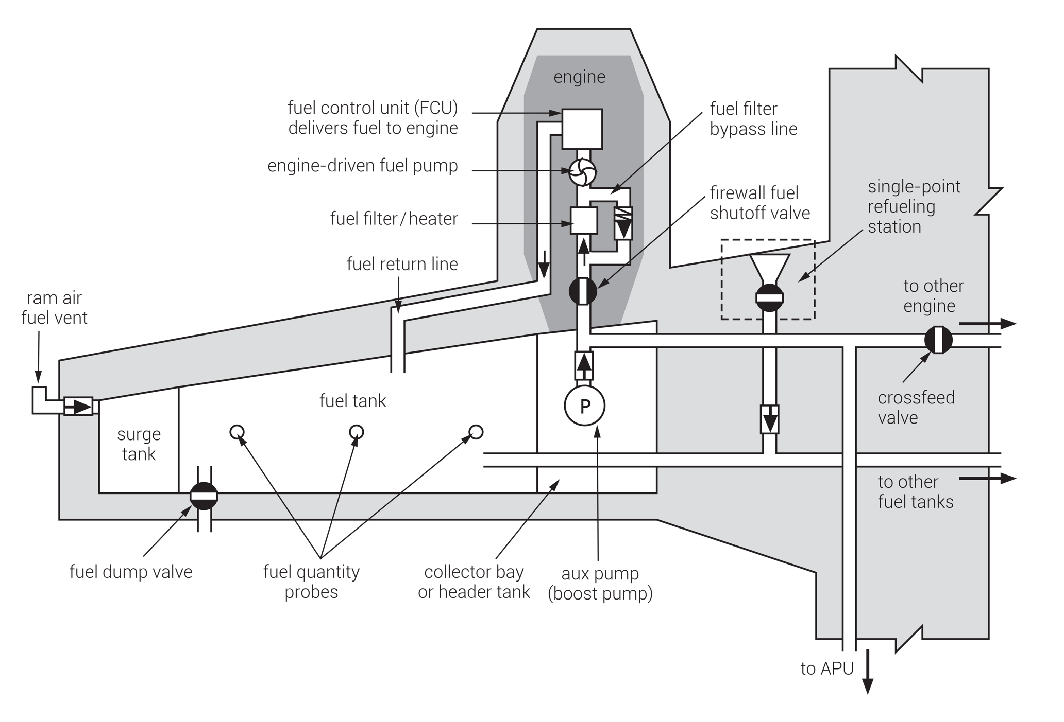
FIGURE 5.19
Fuel system components.

Slide 22
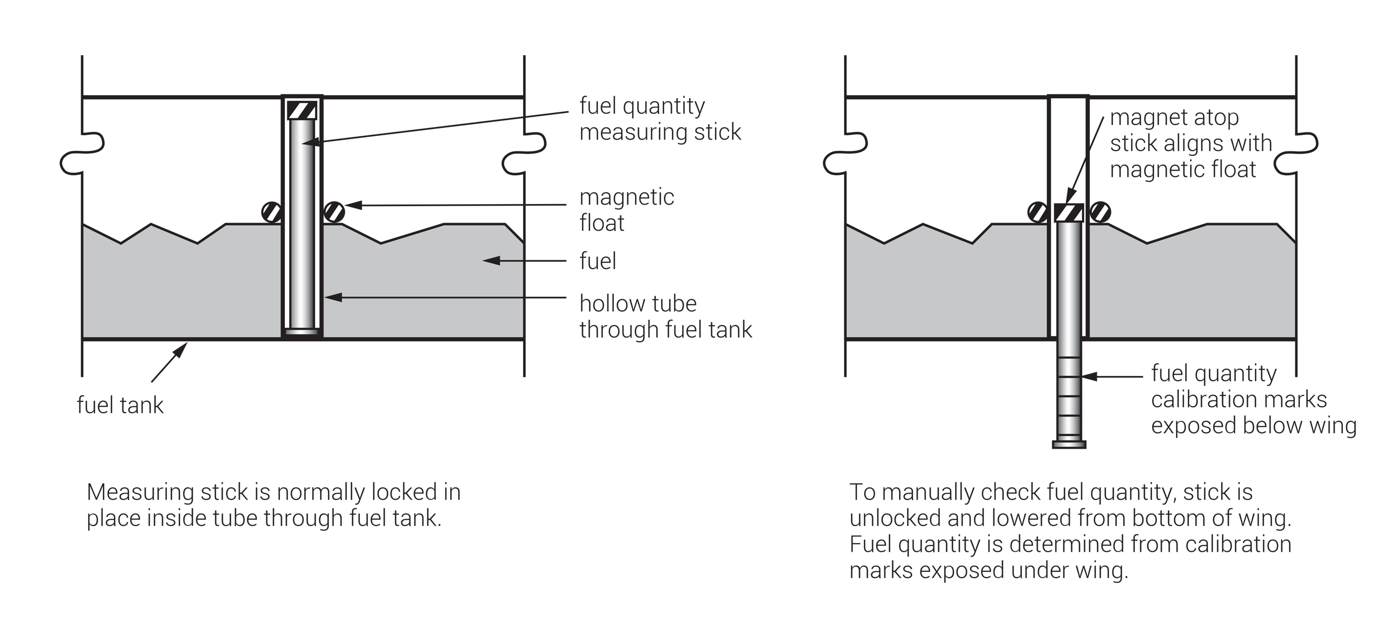
FIGURE 5.20
Magnetic fuel quantity measuring sticks.

Slide 23
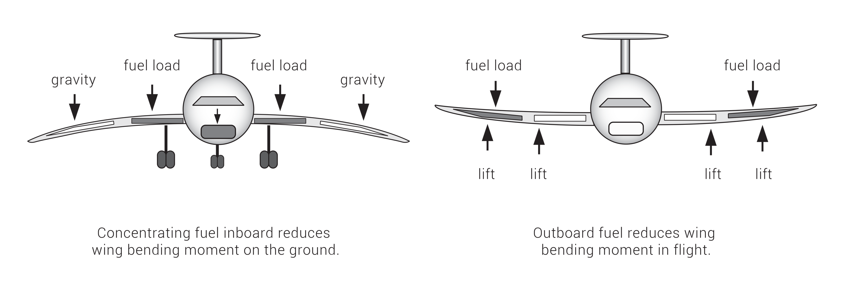
FIGURE 5.21
Effect of lateral fuel balance on wing bending moments.

